Slide 1

Share Rules
Share records with users/groups/roles

Slide 2
Agenda
What is sharing rule & What is the use of sharing ?
Types of sharing rule?
With whom all we can share the record?
How to create Sharing Rules?
Demo
Q & A

Slide 3
Sharing Rules
Sharing rules are used to extend the record level security on top of OWD.
01
With the help of Sharing rules we can extend record level permission.
02
Using sharing rule we can only provide read/edit permission to records.
03
When we share any record it creates a Share Object for that record
04

Slide 4
Types of Sharing Rules
Criteria Based Sharing
Owner Based Sharing

Slide 5
Criteria Based Sharing Rule
Based on some criteria on the records we can share the records.
For example, we have 4 regions APAC, APEC, APEJ & APEG and we wanted to share APAC records with APEC. In this case we should used criteria based as we have a criteria if Region is APAC then share with APEC

Slide 6
Demo
Create a criteria based sharing rule

Slide 7

Owner based sharing rules
Based on owners we wanted to share the records to some roles/groups/user
For example we wanted to share all the Records of CEO with CFO & COO

Slide 8
Demo
Create a owner based sharing rule

Slide 9
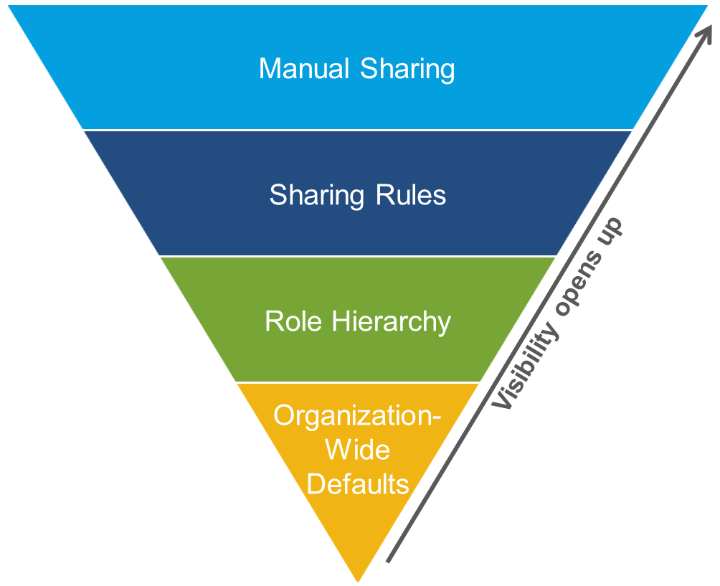
Sharing Architecture

Slide 10

To be continued…

Slide 11

Manual Sharing
Sometimes we need to manually share the records to users/group/roles/roles & subordinates then we go for manual sharing
Sharing button on detail page only become available if the OWD of the object is either private or public read only

Slide 12
Share records using teams
Case Team Member
Account team Member
Opportunity Team Member

Slide 13

Demo
Create Case Team Members & Share a Case
02
Work with Account & Opportunity Team Member
03
Work with default teams
04
Share a record using manual sharing
01

